Slide 1
Geometric Description
Pattern Recognition 2015/2016
Marc van Kreveld

Slide 2
Topics this lecture
Why geometric description for geometric pattern recognition?
Description of size (area, perimeter, diameter, width)
Description of orientation
Description of position
Description of elongation
Description of density (scale-dependent)
Description of clusteredness
Description of auto-correlation (scalar field)

Slide 3
How description can help with pattern recognition
Put the useful description things in a vector and use some vector distance, like length of the difference vector → a feature vector of geometric attributes, so we can apply statistical pattern recognition
area: 12 m²
diameter: 5.8 m
width: 1.6 m
orientation: 40º

Slide 4
Description: measures
Mathematical description or summarizing of data ≈ statistics
Data are often sets of numbers
Describe with:
average
range [min,max]
variance, standard deviation
skewness, kurtosis
histogram (using fixed-interval classification)

Slide 5
Geometric description
Description of a point, polyline, polygon - location - size - orientation - shape
Description of a point set - clustering - density

Slide 6
Description of size
For point: not applicable
For polyline: length or diameter or width
For polygon: area or diameter or width
Diameter: largest distance between two points in the object
Width: smallest distance between two parallel lines that contain the object

Slide 7
Area of a polygon
Polygon without holes
Polygon with holes
(6,8)
(12,7)
(3,5)
(8,6)
(14,6)
(7,4)
(11,3)
(5,1)
Given: cyclic list of points with their coordinates

Slide 8
Idea: area under edge
(6,8)
(6,8)
(12,7)
(12,7)
Area = width times average height = (12 - 6) * (8 + 7)/2 = 45

Slide 9
Area, continued
Edges at “upper side” give positive contribution
Edges at “lower side” give negative contribution

Slide 10
Area formula
Area(P) =
(X₁ - X_{n})(Y₁ + Y_{n})/2 +
Σ (X_{i+1} - X_{i})(Y_{i} + Y_{i+1})/2
n-1
i=1
Assume points given clockwise
Implemented easily with a single for-loop; linear-time computation

Slide 11
Diameter and width
For a polygon or polygonal line, the same as the diameter and width of its convex hull
Suppose the vertices of a polygon are given clockwise
For any three consecutive vertices, remove the middle one if it is a left turn
When the convex hull is obtained, scan opposite sides in rotation and determine the width or diameter
This is a linear-time computation; both steps are linear-time

Slide 12
Description of location
Description of location for an object as two (or three) coordinates (point)
For a point: trivial
Center of mass: for polyline or polygon; can lie outside polygon
Center of largest inscribed circle: for polygon

Slide 13
Center of mass of a polygon
Take arbitrary point p
Make triangles: each side of the polygon and point p
Determine weight (area) and center of mass per triangle
Compute weighted average of the centers of mass
p
Counterclockwise triangles:
positive weight; clockwise triangles: negative weight

Slide 14
Center of mass of a polygon
Center of mass of weighted points: weighted average of the x-coordinates and of the y-coordinates
5
-8
-12
21
11
20

Slide 15
Description of orientation
For polyline:
direction of vector between endpoints
For polygon or polyline:
direction between points realizing the diameter
direction of parallel lines that define width
direction of line that minimizes the average distance of all points in polygon to that line

Slide 16
Description of shape by a number
Elongatedness: 4/π x area / diameter²
Compactness: 1/π x area / (radius smallest enclosing circle)²
Circularity: 4π x area / perimeter²
All between 0 and 1
Based on the isoperimetric inequality: 4πA ≤ L²
For any closed curve, 4π times the area A inside is never more than the curve length L (perimeter) squared

Slide 17
Description of shape by skeleton
Internal skeleton, also: medial axis, or centerline
Voronoi diagram of the edges of the polygon

Slide 18
Computation skeleton
Voronoi diagram of line segments; adaptation of sweep-line algorithm for Voronoi diagram of points
Voronoi edges and vertices outside polygon can be removed later
O(n log n) time for polygon with n vertices
Note: the largest enclosed circle of the polygon has its center on a Voronoi vertex
Also note: this is hardly a short or summarizing description

Slide 19
Description of shape of a polyline or boundary of a polygon
Sinuosity: total angular change
Curviness: average change of angle (per unit of length)
Number of inflection points:
Smooth curve: second derivative is zero
Polygonal curve: a turn left (right) followed by a turn right (left)

Slide 20
Description of shape of a polyline or boundary of a polygon at a point
Tangent line direction
Curvature
Smooth curve: second derivative
Polygonal curve: discrete curvature via the osculating circle
discrete curvature here

Slide 21
Description of shape of a polyline or boundary of a polygon at a point
Tangent line direction
Curvature
Smooth curve: second derivative
Polygonal curve: discrete curvature via the osculating circle
choose points a given distance
forward and backward along
the curve

Slide 22
Description of shape of a polyline or boundary of a polygon at a point
Tangent line direction
Curvature
Smooth curve: second derivative
Polygonal curve: discrete curvature via the osculating circle
make the circle through these three points and take the curvature of that circle
tangent circle: the unique circle whose position, tangent and curvature corresponds to the curve

Slide 23
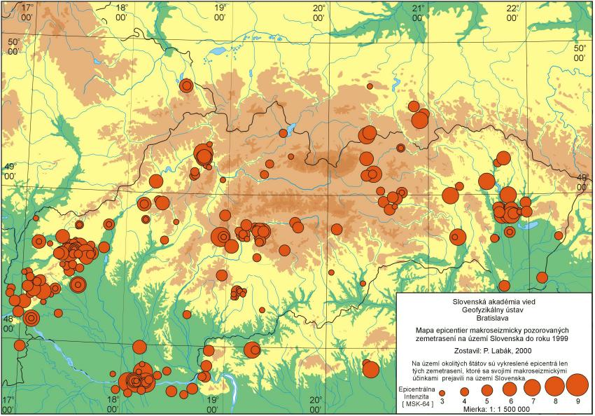
Description of point sets
Clustering
Density
Examples of point sets to be analyzed
epicenters of earthquakes
occurrences of road accidents in a city
burglary locations
proportional symbol map

Slide 24
Description of point sets
Clustering: even, random, clustered distribution
E.g., compare actual nearest neighbor distance with nearest neighbor distance of random set

Slide 25
Description of point sets
Density: scale-dependent, locally defined
point count inside a square or circle;
size determines the scale of interest

Slide 26
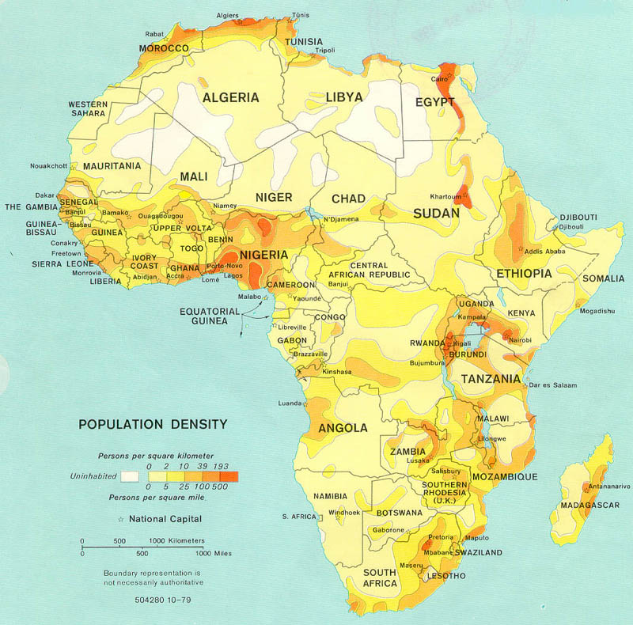
Example of density
Population density

Slide 27
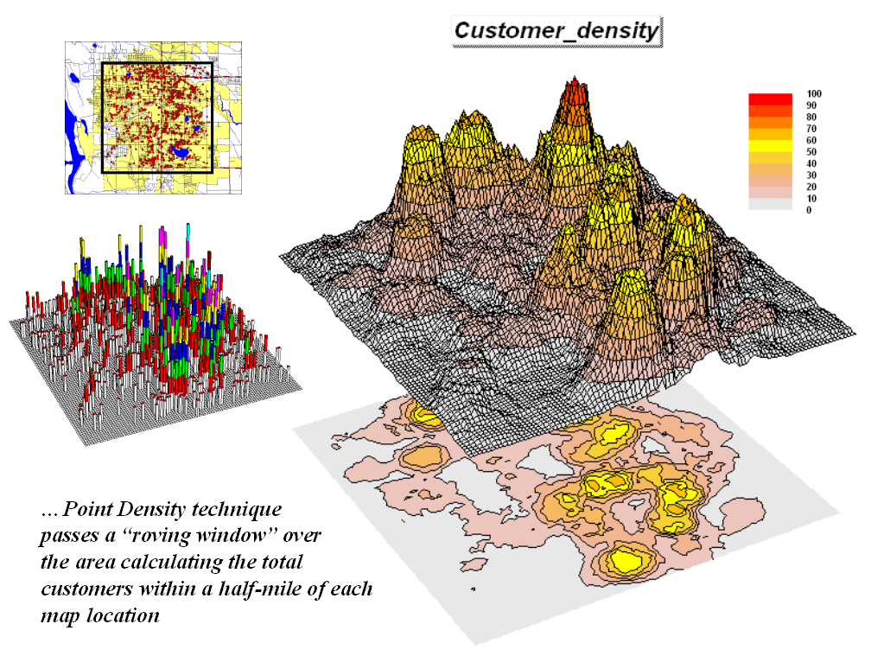

Slide 28
Description of point sets
Common simple approach: fixed grid count (essentially, a 2D version of a histogram)

Slide 29
Description of valued point set
Scalar field data, known from point measurements
Spatial autocorrelation: degree in which closer measurements are more alike in value than any two measurements
11
10
12
12
13
14
19
21
20
16
22
17
18
16
21
15

Slide 30
Description of valued point set
Temperature at location x and 5 km away from x is expected to be nearly the same
Elevation (in Switzerland) at location x and 5 km away from x is not expected to be related (even over 1 km), but it is expected to be nearly the same 100 meters away
Other examples:
depth to groundwater
soil humidity
nitrate concentration in the soil

Slide 31
Description of valued point set
auto-correlation (~ up to what distance are measured values “similar”, or correlated)
11
10
12
12
n points → (n choose 2) pairs; each pair has a distance and a difference in value
13
14
19
21
20
16
22
17
18
16
21
15

Slide 32
2
difference
Average difference ≈ observed expected difference
2
2
distance
distance
Classify distances and determine average per class

Slide 33
Observed variogram
Model variogram (linear)
Average difference ≈ observed expected difference
2
sill
2
nugget
distance
range
distance
Smaller distances → more correlation, smaller variance

Slide 34
Importance auto-correlation
Descriptive statistic of a data set: describes the distance-dependency of auto-correlation
Interpolation based on data further away than the range is nonsense
11
10
12
16
13
20
21
??
14
16
22
17
19
18
12
21
15
range

Slide 35
Importance auto-correlation
If the range of a geographic variable is small, more sample point measurements are needed to obtain a good representation of the geographic variable through spatial interpolation → influences cost of an analysis or decision procedure, and quality of the outcome of the analysis

Slide 36
Capturing neighborhood of a polygon or polygonal line
Simplest formalization of neighborhood: everything within a given distance
Also called buffer region
Computed by taking the Minkowski sum with a disk
Comparable to the dilation operator in raster graphics

Slide 37
Buffer of a polyline
Buffer = Minkowski sum with a disk
A polyline gives a polygon with holes

Slide 38
Buffer computation: divide & conquer
Split polyline in two
Compute the buffer of the halves recursively
Merge the buffers to one buffer

Slide 39
Buffer complexity
Two non-intersecting line segments S₁ and S₂
Consider the buffers of S₁ and S₂
They intersect at most twice
So a set of buffers of non-intersecting line segments is a set of pseudo-discs

Slide 40
Buffer complexity
Theorem (13.9 of computational geometry book):
Let S be a collection of [polygonal] pseudodiscs with n edges in total. Then the complexity of their union is O(n)
Corollary: The buffer of a polygonal line consisting of n edges (or n+1 points) has complexity O(n)

Slide 41
Merge buffers to one
Assume we merge the buffers of polylines having m₁ and m₂ edges
Do an “ordinary” line sweep over the
O(m₁) + O(m₂) segments and circular arcs of the buffers
Cost: O((m₁+m₂+k) log (m₁+m₂+k)) time for the merge

Slide 42
How many intersection points?
In general: m₁ and m₂ line segments can intersect m₁m₂ times, so k ≤ m₁m₂
Here: Every intersection point is a vertex of the buffer after the merge, so of a polyline with m₁+m₂ edges
This new buffer has complexity O(m₁+m₂) according to the corollary, so k = O(m₁+m₂)
Hence, the merge takes O((m₁+m₂) log (m₁+m₂)) time

Slide 43
The algorithm
If n >1, split polyline with n edges into two parts with n/2 edges each
Compute the buffer of each part recursively
Merge the buffers of the parts into one using plane sweep, in O(n log n) time
Recurrence: T(n) = 2 T(n/2) + O(n log n)
Gives T(n) = O(n log² n) time (e.g. by induction)

Slide 44
Summary
There are many possible spatial descriptors (measures) for geometric objects
Different descriptors have different applications
Computation of some measures/descriptors requires advanced geometric algorithms

